Slide 1
Verification of the effect of μa change on Spo2
08/24/2023
Yu Li

Slide 2


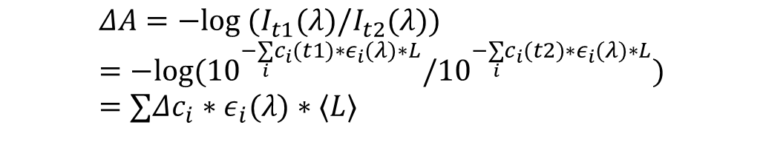
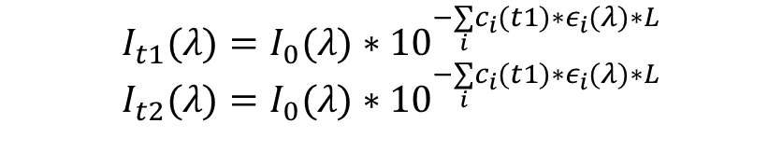
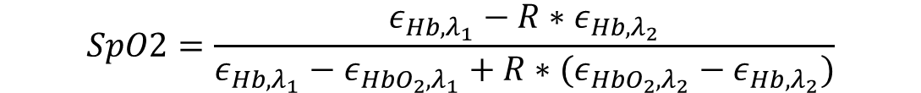
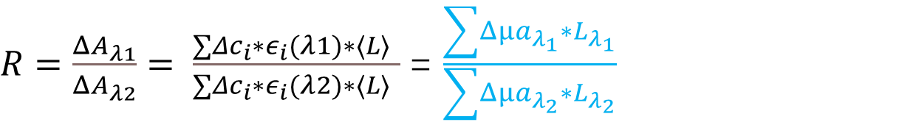
Formula deduction process
$$I_{t1}(λ)=I_{0}(λ)∗{10}^{−\underset{i}{∑}c_{i}(t1)∗ε_{i}(λ)∗L}$$
$$I_{t2}(λ)=I_{0}(λ)∗{10}^{−\underset{i}{∑}c_{i}(t1)∗ε_{i}(λ)∗L}$$
$$ΔA=−log (I_{t1}(λ)/I_{t2}(λ))=−log({10}^{−\underset{i}{∑}c_{i}(t1)∗ε_{i}(λ)∗L}/{10}^{−\underset{i}{∑}c_{i}(t2)∗ε_{i}(λ)∗L})=∑Δc_{i}∗ε_{i}(λ)∗⟨L⟩$$
$R=\frac{ΔA_{λ1}}{ΔA_{λ2}}= \frac{∑Δc_{i}∗ε_{i}(λ1)∗⟨L⟩ }{∑Δc_{i}∗ε_{i}(λ2)∗⟨L⟩ }$= $\frac{\sum{Δ{μa}_{λ_{1}}}∗L_{λ_{1}}}{\sum{Δμa_{λ_{2}}}∗L_{λ_{2}}}$
Reference :
Design and In Vivo Evaluation of a Non-invasive Transabdominal Fetal Pulse Oximeter.
$$SpO2=\frac{ε_{Hb,λ_{1}}−R∗ε_{Hb,λ_{2}}}{ε_{Hb,λ_{1}}−ε_{HbO_{2},λ_{1}}+R∗(ε_{HbO_{2},λ_{2}}−ε_{Hb,λ_{2}})}$$

Slide 3
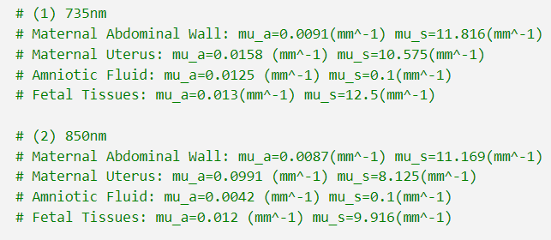

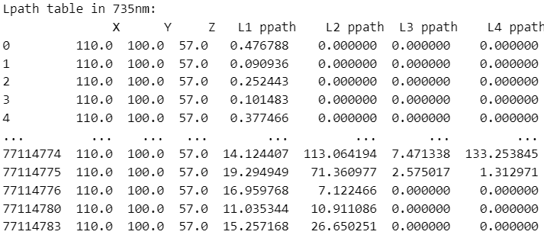
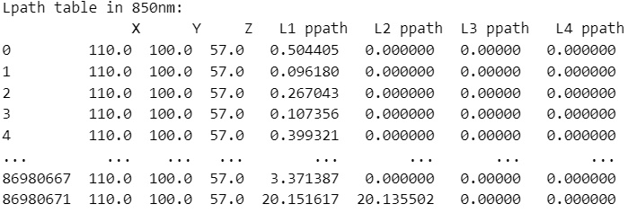
Data preparation and experimental setup
We used the collaborator’s μa data at 735nm, 850nm.
For the L path data, we separated the case where the SD distance is 110mm. Under the two wavelengths, the sum of each layer L is basically the same, indicating that this separation is feasible

Slide 4
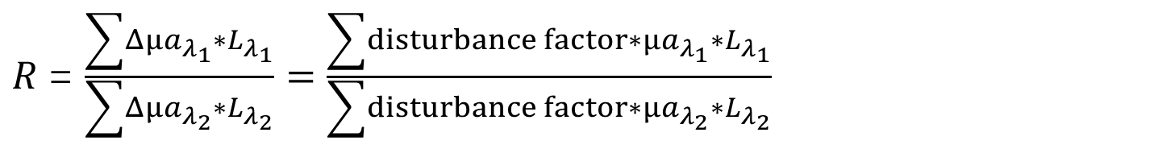
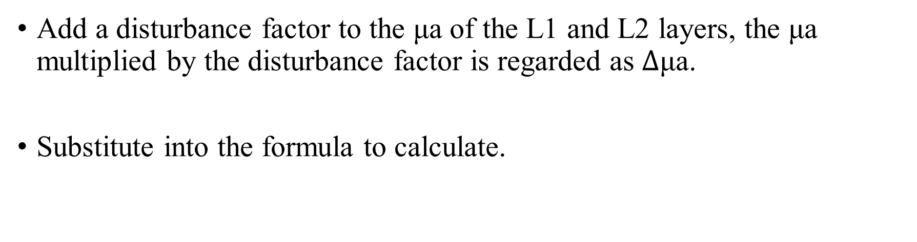
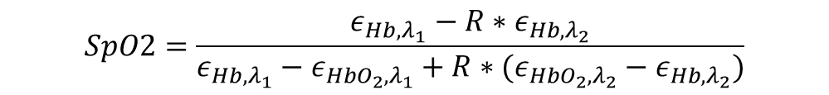
Effects of μa change
Add a disturbance factor to the μa of the L1 and L2 layers, the μa multiplied by the disturbance factor is regarded as $Δ$μa.
Substitute into the formula to calculate.
$R$= $\frac{\sum{Δ{μa}_{λ_{1}}}∗L_{λ_{1}}}{\sum{Δμa_{λ_{2}}}∗L_{λ_{2}}}=\frac{\sum{disturbance factor∗{μa}_{λ_{1}}}∗L_{λ_{1}}}{\sum{disturbance factor∗μa_{λ_{2}}}∗L_{λ_{2}}}$
$$SpO2=\frac{ε_{Hb,λ_{1}}−R∗ε_{Hb,λ_{2}}}{ε_{Hb,λ_{1}}−ε_{HbO_{2},λ_{1}}+R∗(ε_{HbO_{2},λ_{2}}−ε_{Hb,λ_{2}})}$$

Slide 5
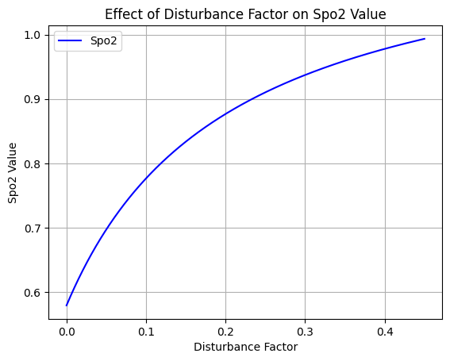
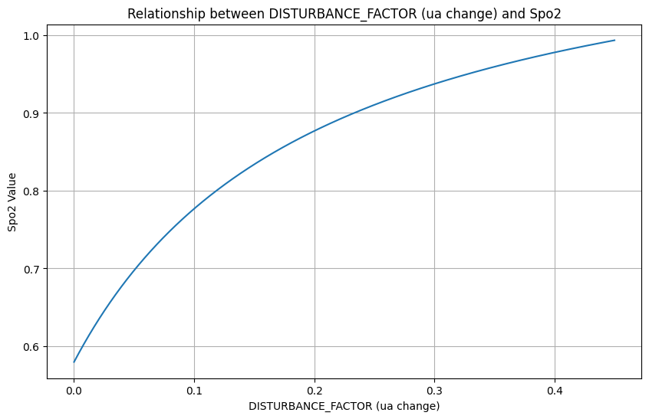
Effects of μa change
After testing, it is appropriate to set the disturbance factor between 0 and 0.45.
This also means that the change of μa is limited to a certain range, and the change of spo2 can be fitted, and the change state of spo2 can be obtained by analyzing the change state of μa.
Correlation analysis：
Pearson Correlation Coefficient between DISTURBANCE_FACTOR and Spo2: 0.957

Slide 6
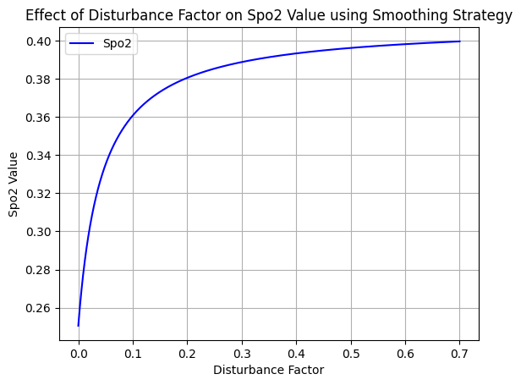
Problem analysis
Spo2 can only vary between 0.55 and 1.
It is speculated that it is related to the coefficient of the model. After replacing another set of model coefficients, the general trend of change remains unchanged, but the value changes greatly.
It can be considered that there is a correlation between the change of μa and spo2, but the specific implementation requires more accurate μa parameters.

